Slide 1

Predicting New Listing Price at Airbnb
Group 5 High Five A++
Abhishek Saha Sameen Haroon
Sharon Xu Zeyu Zhu

Slide 2



Goal: Help Airbnb recommend prices for new listings using machine learning techniques
Airbnb is an online marketplace & hospitality services company
Serves as broker for transactions on its business platform and earns through commission.
Primary revenue stream has traditionally been real estate listings
Listing price is a major factor in a guest’s decision to rent, and is dependent on multiple attributes.
Accurate price prediction can prevent business loss from both high and low prices.
This can increase revenue for the listing owner and commission for Airbnb.
Owners provide features of their new listing on Airbnb.
Model predicts price based on those features and general historical data for listings
The predicted value is provided to the owner as a suggested listing price on the Airbnb platform

Slide 3



Starting point: Take a closer look at the data and make necessary changes
Transformation
Cleaning
Exploration

Slide 4




Data exploration
Data source: Kaggle, www.kaggle.com/rudymizrahi/airbnb-listings-in-major-us-cities-deloitte-ml
Data details: 74,111 observations
Target variable: Listing price (logged)
Features: 28 in total, examples below
Location
zip code
city
Rental type
property type
room type
Capacity
bedrooms
accommodates
Amenities
wireless internet
air conditioning

Slide 5
Data cleaning
Initial feature selection
Removed irrelevant features e.g. id, picture url
Clean values
Cleaned zipcode to convert all to 5-digits codes
Drop missing values
Removed 345 rows with missing entries
Removed out-of-scope features e.g. listing description
Removed features due to leakage e.g. number of reviews, host response
computationally challenging to impute
existing data set is already large

Slide 6
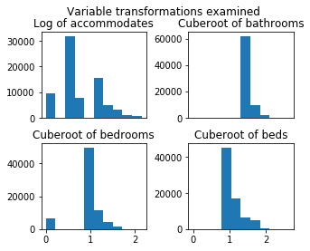


Data transformation:
Result is 839 columns including 834 dummy variables
Numerical
Categorical
No negatives or obvious outliers observed in data
No distribution benefits observed from transformation
Parsed lists of strings in amenities into 130 dummy variables
Encoded 6 categorical variables into 700 binary variables (dropped the first category of each to avoid multicollinearity)
Transformed 4 true/false objects to binary variables

Slide 7
Modeling: Combination of hold-out testing & cross-validation, implemented in AWS
Training
Test
Initial holdout split
70%
30%
1
2
3
4
10
… …
Parameter tuning via cross-validation (grid search)
Hold-out fold
Best parameters chosen on
mean-squared error. Model then fitted on training data
Final model evaluated for each algorithm on test data

Slide 8
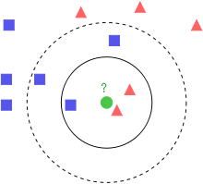
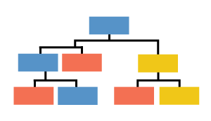
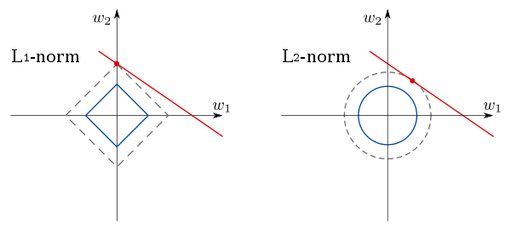
Modeling: Four different machine learning algorithms
k-NN Regression
Regression Tree
Lasso Regression
Ridge Regression
Techniques
Feature selection
Variance reduction via ‘Extra Tree Regressor’
Automatic feature selection via variance reduction
Automatic feature selection, with help from regularization
No direct selection, uses regularization for simplicity

Slide 9
Based on test set performance, Lasso emerges as the best model
Ridge & Lasso both gave comparable performance on RMSE
However, Lasso is seen as the better model because it provides sizeable feature reduction (377 columns vs 838)
That said, it is worth noting that all models’ RMSE are point-estimates, actual distributions may vary
Most models had consistent performance on training data. k-NN performed noticeably better on training data, likely due to overfitting

Slide 10
Final model evaluation indicates there may be room for further feature inclusion
Root Mean Squared Error
119.83
Overall value is high, given that the average price is $160
Mean Absolute Error
52.53
Explained variance score
0.49
There is still a large share of patterns that are unexplained in our data
The substantially lower MAE indicates that on average, our model provides much better predictions.
This is likely a reflection of the large penalty associated with high magnitude errors
This suggests that the high magnitude errors driving RMSE are infrequent.
Takeaways:
There are still important features that are excluded from our analysis
Additional iterations that encompass these features can improve predictions
There will always be variables that influence optimal price but are collected later e.g. reviews

Slide 11
Ultimately, accurately predicting new listing price can unlock substantial business value
The business use-case
Why it matters
For new listers, starting off with the right price is critical to early success. This model will compares available features with historical data to suggest a price for the listing.
Using the suggested price from the model, new listers are more likely to set the price in the right range, thus:
Listers maximize revenue gain
Airbnb can better forecast revenue stream
More broadly, price optimization can be further used to adapt listing prices over time e.g. help owners price based on seasonal demand patterns
In the absence of optimal pricing, two scenarios can occur:
Over-priced listings:
Few early rentals: Lost business
Those who rent tend to leave bad reviews. This has a huge negative impact on the chance of further rentals
Owner suffers, as does Airbnb revenue stream
Under-priced listings:
Losing out on potential revenue
May hurt other Airbnb listings in the area

Slide 12


However, there are some additional considerations to keep in mind
Deployment considerations
Hosts may not provide adequate features to accurately estimate the price, failing to capture rental value
These can be reduced by choosing top 5-6 high impact features and making them mandatory for hosts
Ethical considerations
Future models could lead to price discrimination based on data on the host or guest
Consistently over-priced predictions can potentially drive up real estate prices

Slide 13

Thank you!
Questions?

Slide 14
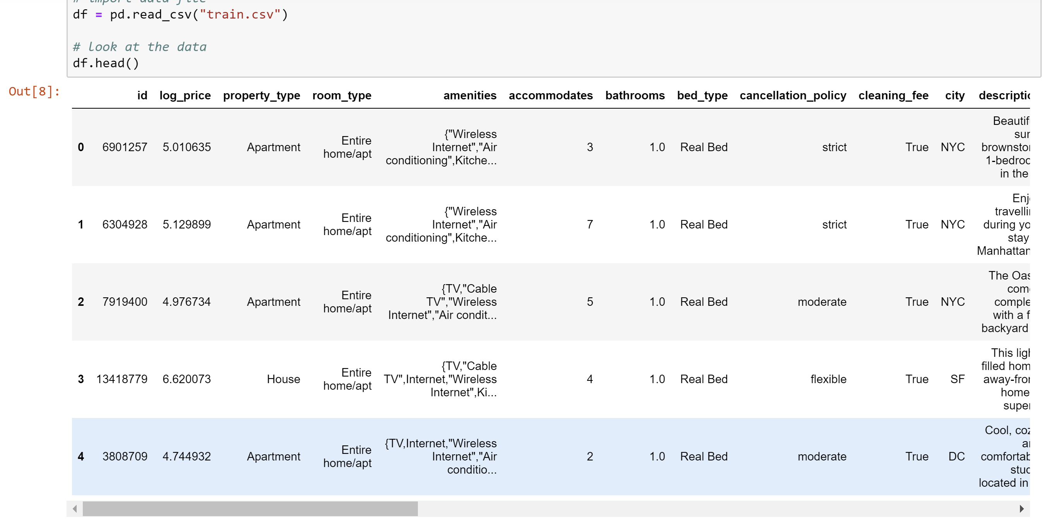
Appendix 1: Data exploration

Slide 15
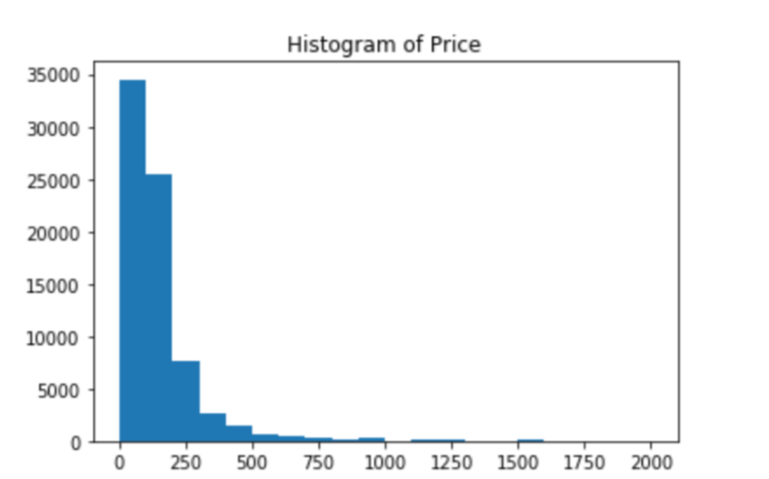
Appendix 2: Distribution of price

Slide 16
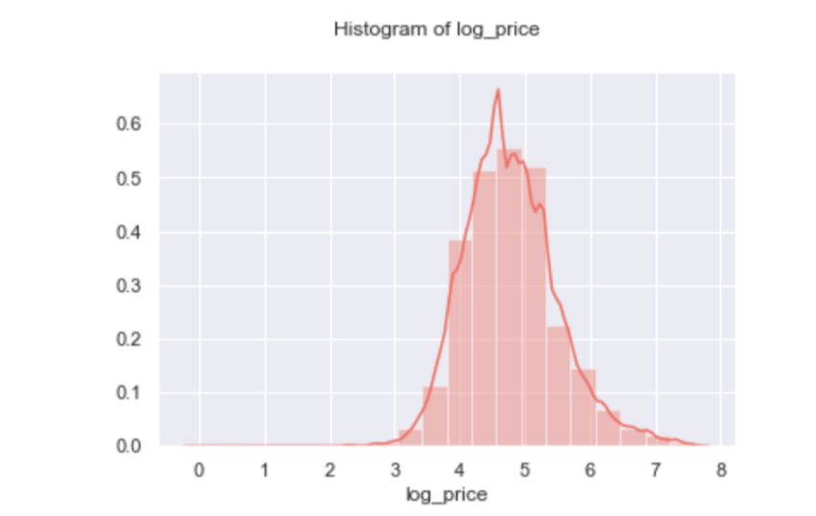
Appendix 3: Distribution of log(price) shows a normal distribution

Slide 17
Appendix 4: Original features
Variable | Type | Notice
property_type | Object; categorical
room_type | Object; categorical
amenities | Object | Contains NA
accommodates | Integer; numerical
bathrooms | Float; numeric
bed_type | Object; categorical
cancellation_policy | Object; categorical
cleaning_fee | Boolean; binary
city | Object; categorical
description | Object; string
first_review | Object; date | Contains NA
host_has_profile_pic | Object; binary | Contains NA
host_identity_verified | Object; binary | Contains NA
host_response_rate | Object; string | Contains NA; can be transformed to float
host_since | Object; date | Contains NA
instant_bookable | Object; binary | Can be transformed to boolean
last_review | Object; date | Contains NA
latitude | Float; numerical
longitude | Float; numerical
name | Object; string
neighbourhood | Object; categorical | Contains NA
number_of_reviews | Integer; numerical
review_scores_rating | Float; numerical | Contains NA
thumbnail_url | Object; string | Contains NA
zipcode | Object; string | Contains NA
bedrooms | Float; numerical | Contains NA
beds | Float; numerical | Contains NA

Slide 18
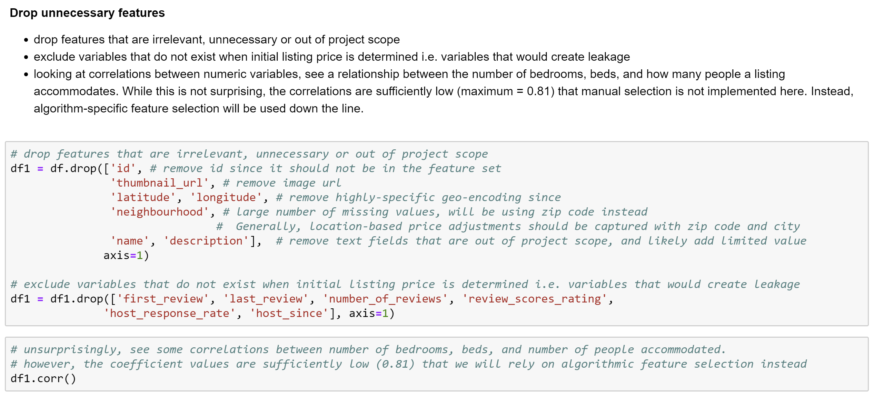
Appendix 5: Drop unnecessary features

Slide 19
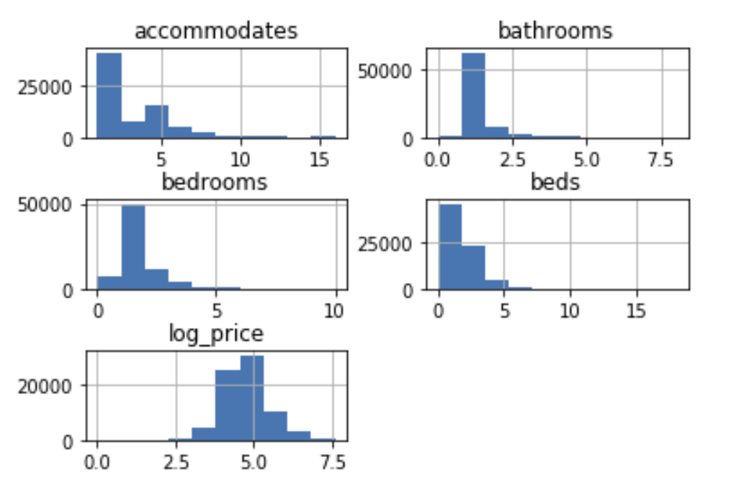
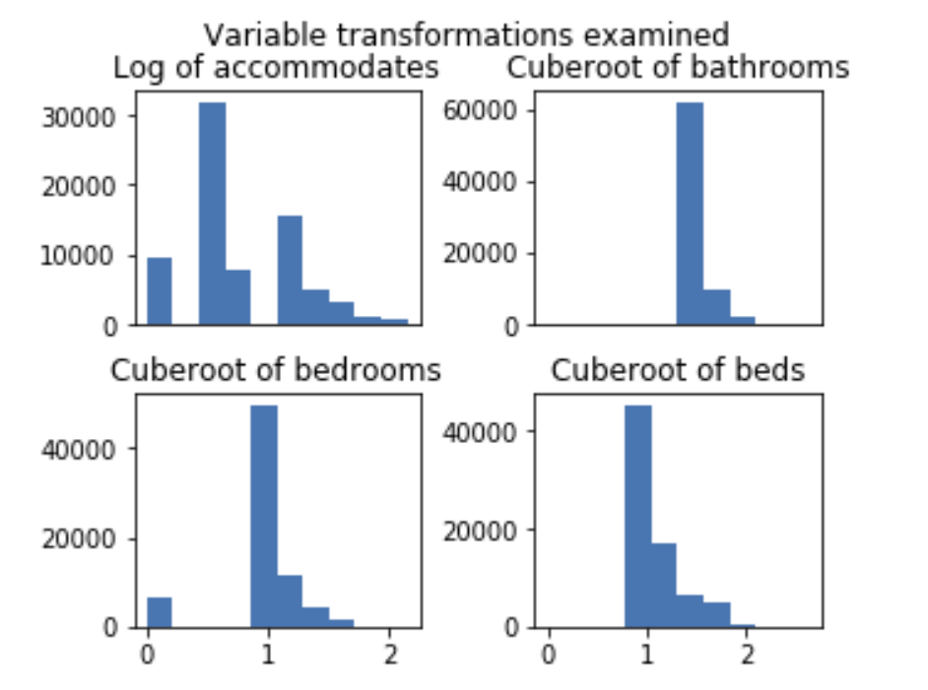
Appendix 6: No value gained from numeric variables transformation
Original distributions

Slide 20
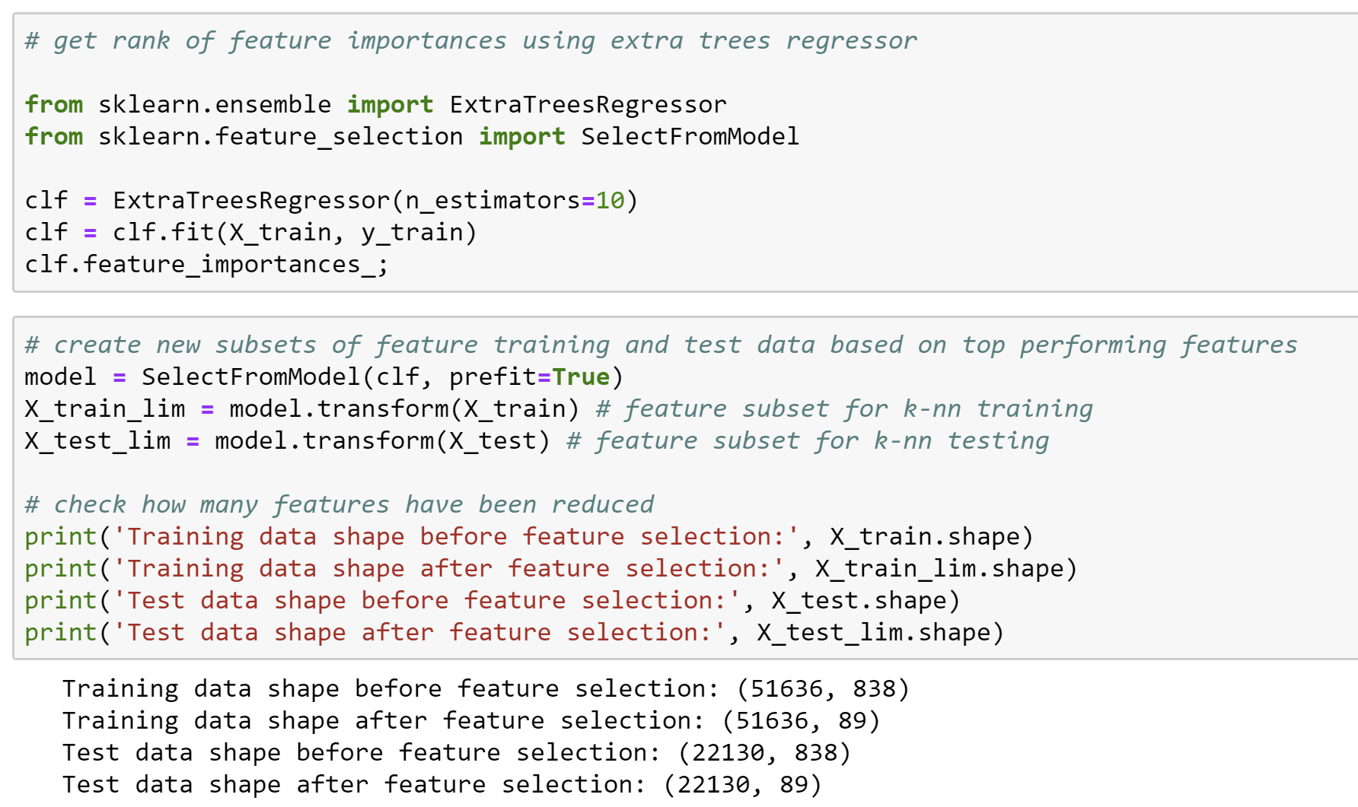
Appendix 7: Feature selection for kNN regression

Slide 21
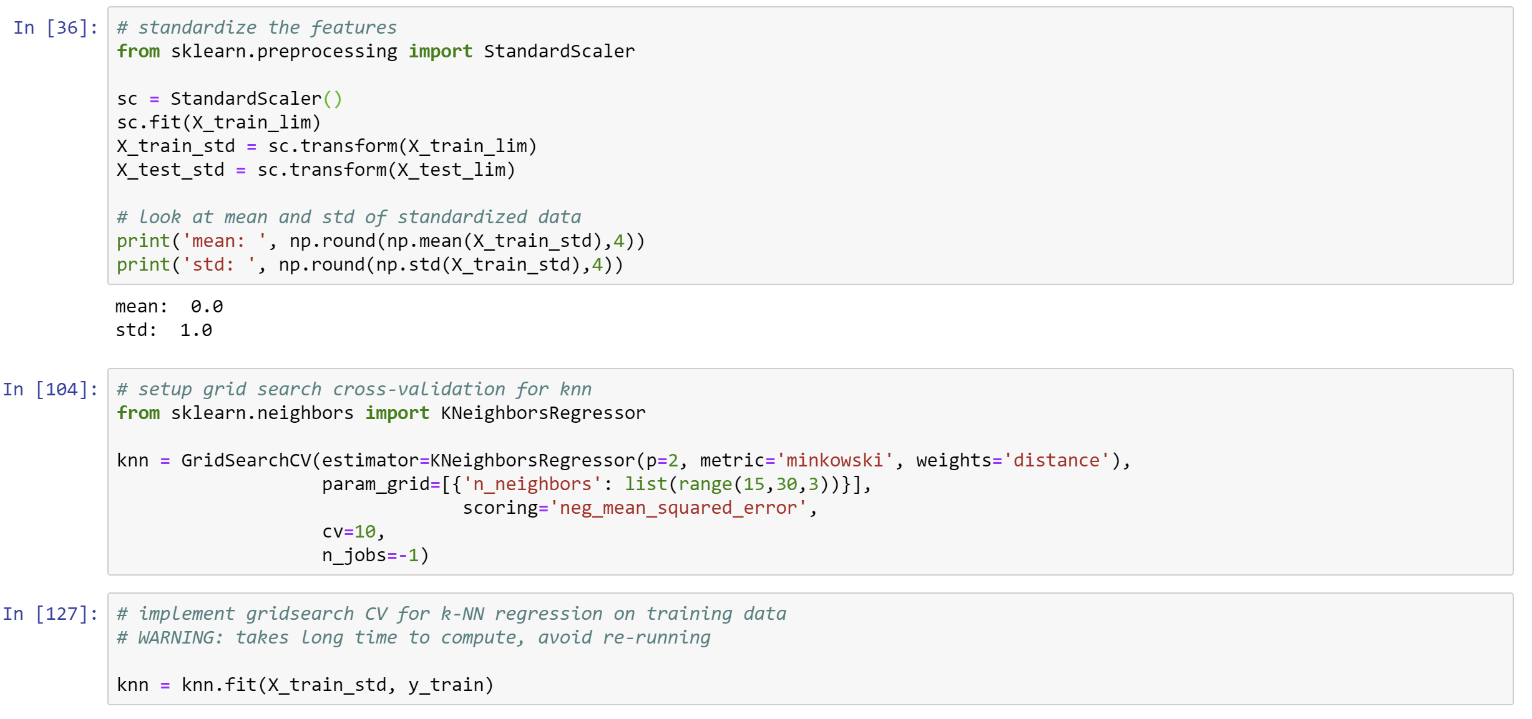
Appendix 8: Model example: standardization & fit for kNN regression

Slide 22
Appendix 9a: Regression tree
Parameter ranges evaluated
Overall results
Max_depth: [3, 4 , 5, 6...16]
Min_samples_leaf: [100, 500, 1000, 2000, 5000],
Max_leaf_nodes: [20, 25, 30...60]
Root mean squared error
Optimal parameters found
Max_depth: 13
Min_samples_leaf: 55,
Max_leaf_nodes: 100
Mean absolute error
Learnings
Explained variance score
The feature ‘Private room’ provided the maximum variance reduction
Almost consistent performance across training set and test set

Slide 23
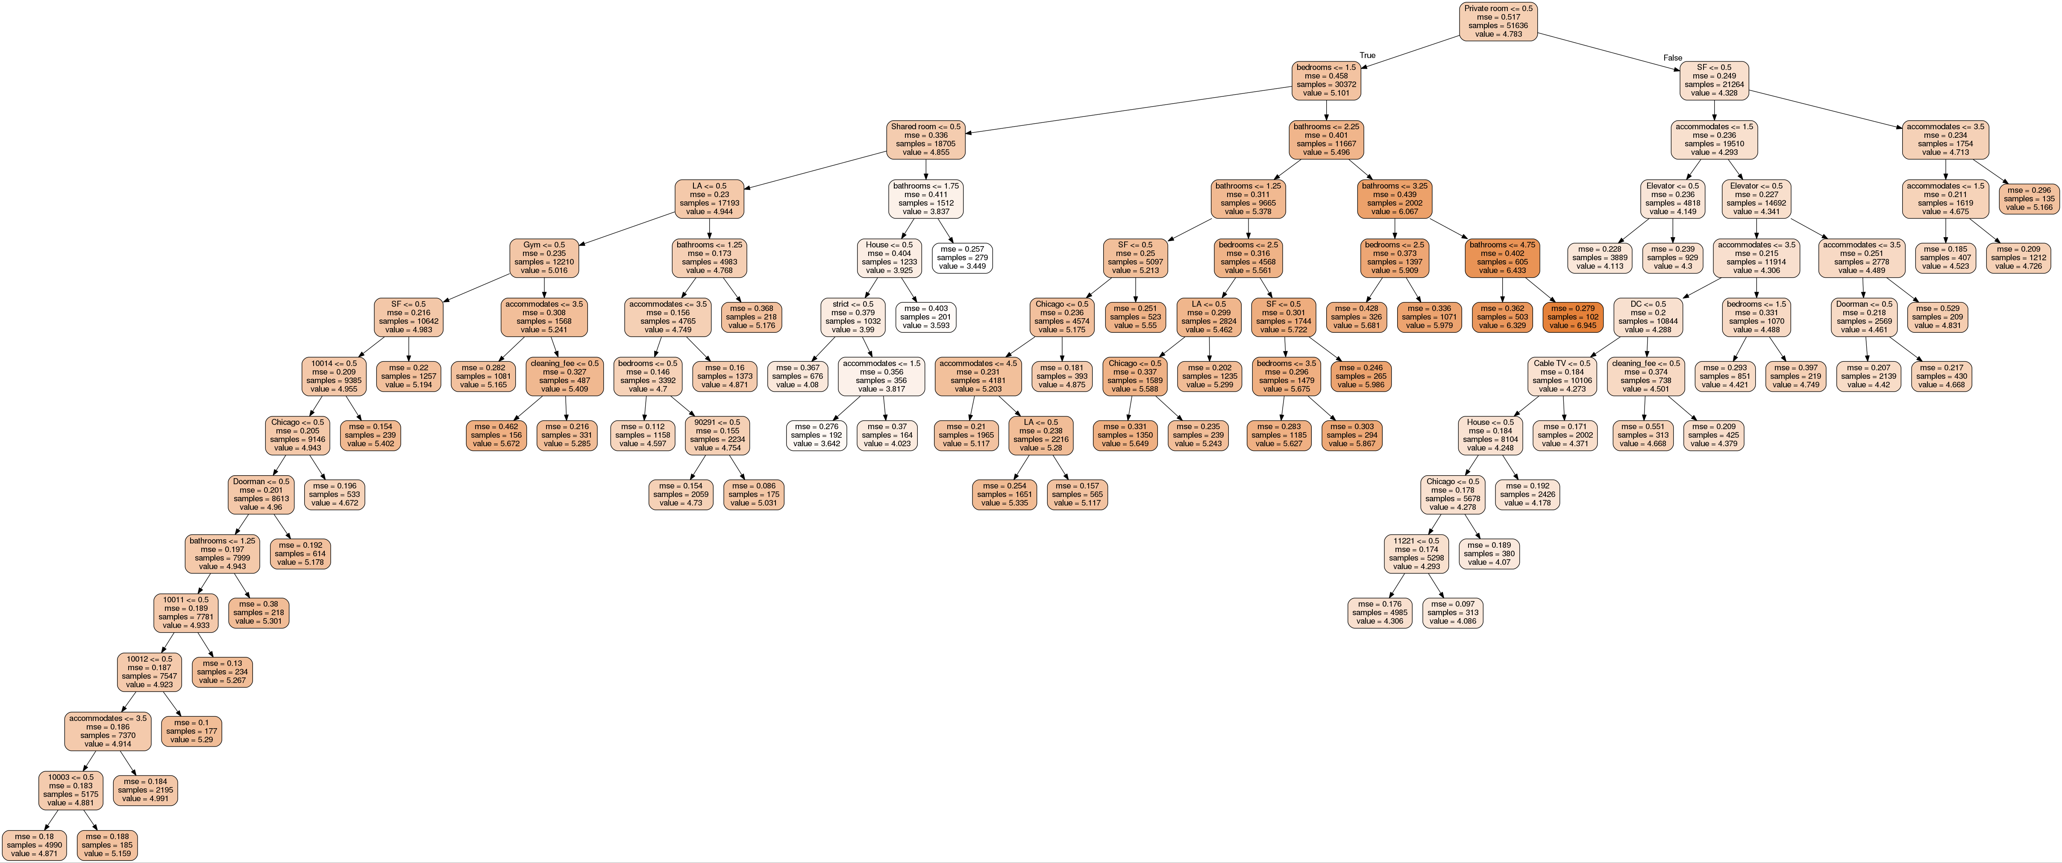
Appendix 9b: Regression tree

Slide 24
Appendix 10: k-NN Regression
Parameter ranges evaluated
Overall results
k: [9, 11, 13, 15, 17, 19], [15, 18, 21, 24...31]
two iterations of cross-validation used to evaluate both sets of k-values (on training data only)
Root mean squared error
Optimal parameters found
k: 18
Weights: distance
Mean absolute error
Learnings
Explained variance score
Highly overfitting the training set
Maybe impractical for this large a data set since its computationally expensive

Slide 25
Appendix 11: Lasso Regression
Parameter ranges evaluated
Overall results
Alpha: [0.00001, 0.0001, 0.001, 0.01, 0.1, 1, 5, 10, 50, 100, 500]
Root mean squared error
Optimal parameters found
Alpha: 0.00001
Mean absolute error
Learnings
Lowest alpha value was selected as optimal parameter. It is worth noting that this produced occasional convergence challenges during cross-validation
Reduced feature set substantially
Consistent performance across training and test set
Explained variance score

Slide 26
Appendix 12: Ridge Regression
Parameter ranges evaluated
Overall results
Alpha: [0.00001, 0.0001, 0.001, 0.01, 0.1, 1, 5, 10, 50, 100, 500]
Root mean squared error
Optimal parameters found
Alpha: 1
Mean absolute error
Learnings
Explained variance score
Similar performance to Lasso regression
Consistent performance across training & test sets

Slide 27
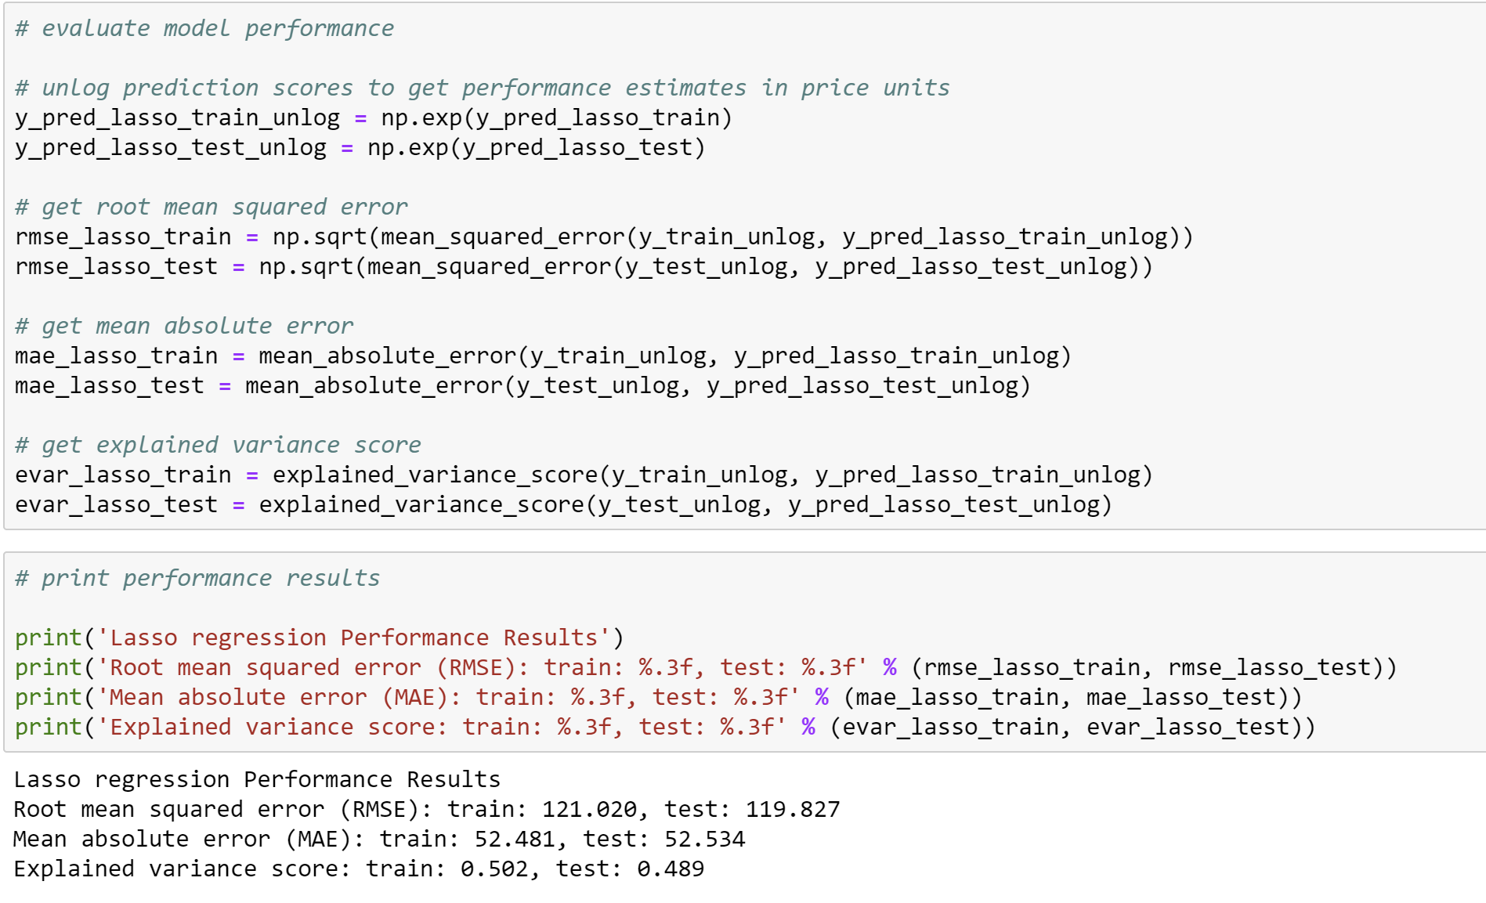
Appendix 13: Converting log(price) to price for final model evaluation

Slide 28
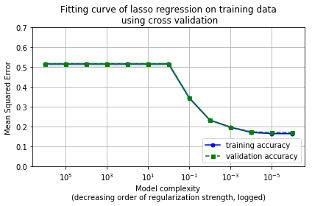
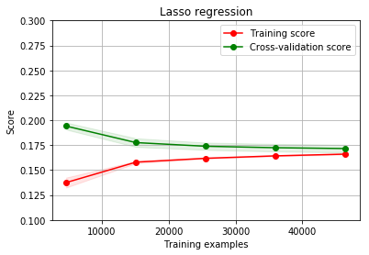
Appendix 14: A closer look at the final model: fitting and training curves
Chose value of alpha with lowest mean squared error on validation data, before plateau
Expected convergence observed for larger data

